Slide 1
Project One
It's The Hot Knock Life
Colleen Daily, Hao Dong, Stefan Johnson, and Ana Stefanski

Slide 2
Hypothesis: With climate change, we predict that there is a greater strain on quality of life

Slide 3
Decompose
Hypothesis: With climate change, we predict that there is a greater strain on quality of life
Defining climate change as extremes in both heat index, wind speed, and precipitation
Quality-of-life measures are defined by crime rates, property values, and traffic fatalities
Four of the most populous cities in the United States: New York, Los Angeles, Chicago, and Philadelphia
Measuring our hypothesis with U.S. cities allows us to measure climate change on quality of life without having to resolve socioeconomic factors that would interfere with measuring the data set

Slide 4
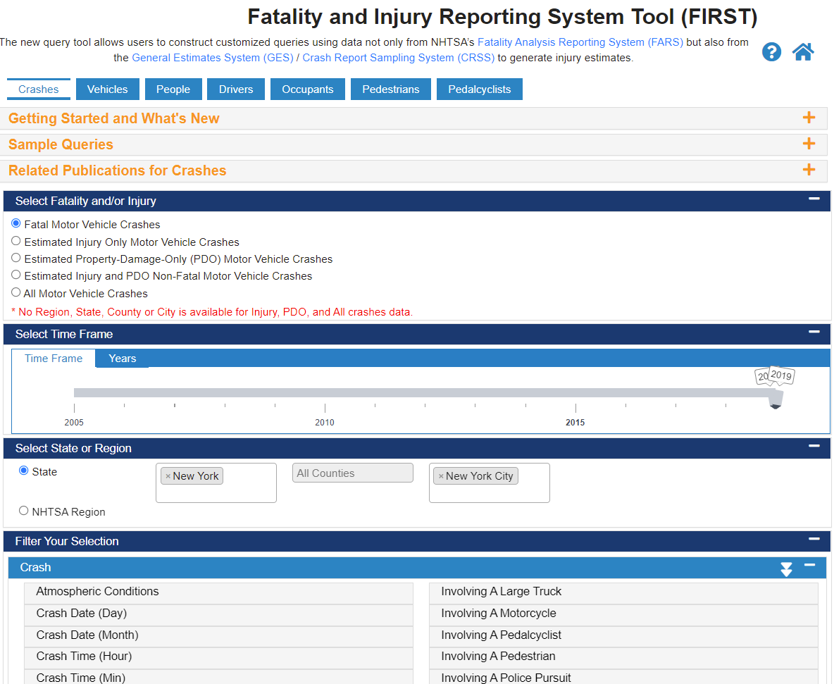



Data Retrieval
Quality-of-life measures began by finding the Open Data Websites for the four major cities
Crime Data
Traffic Fatality
Federal Housing Finance Agency
Weather from Meteostat.net
Temperature
Wind speed
Precipitation
Due to data availability we decided on 2012 and 2019. Earlier than 2012 datasets were not available for all cities.

Slide 5
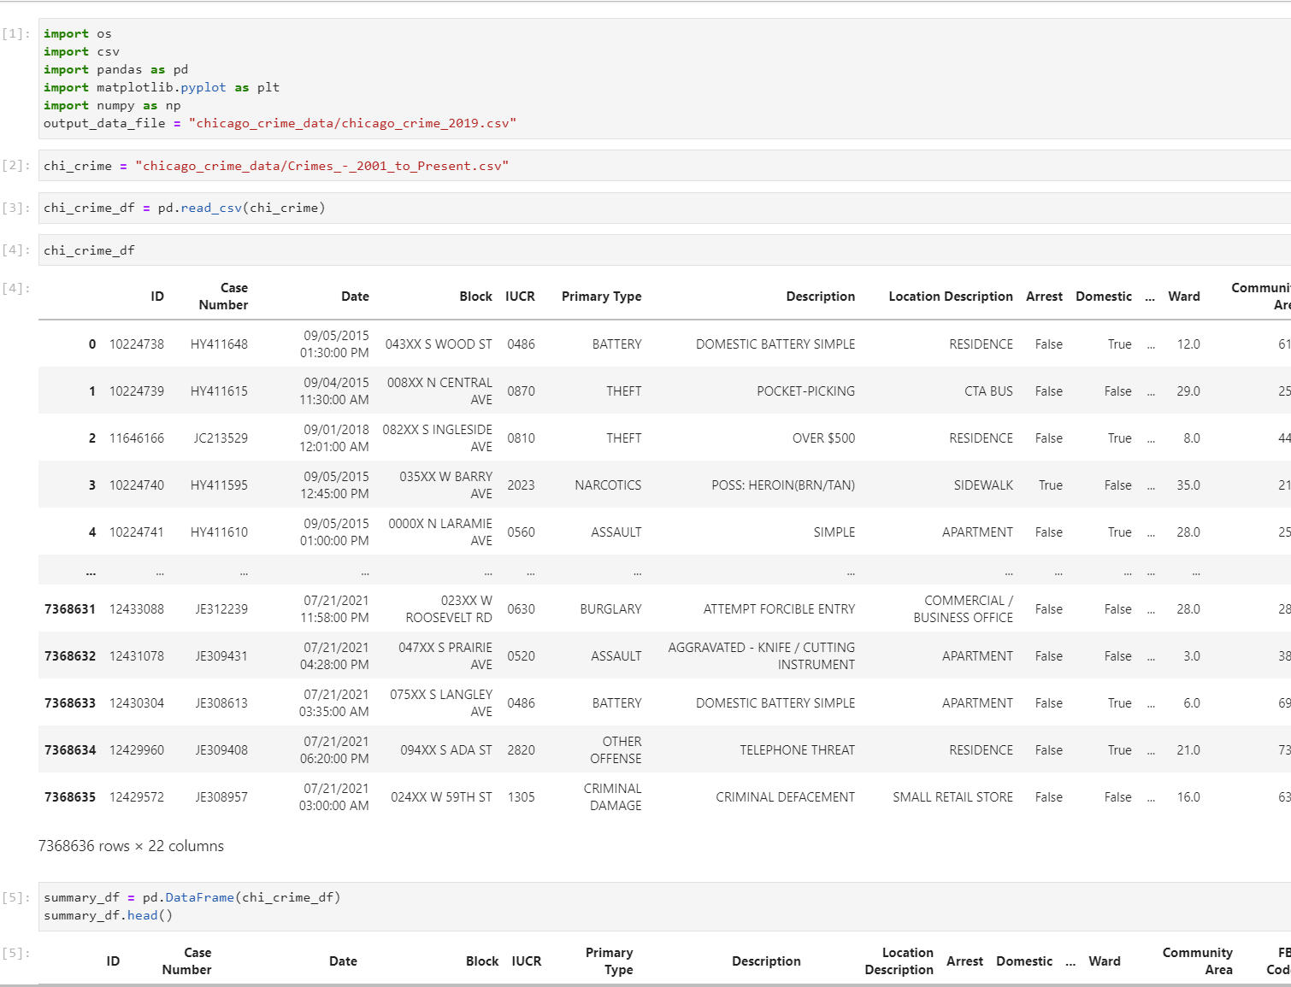
Data Cleaning
Jupyter Lab was used heavily to clean the data
The largest data set was for crime rates, with more than 7 million lines of data
Traffic Fatalities, Property Values, and Weather data sets were less cumbersome
Removed & renamed columns
Datetimeindex
Groupby month
Valuetype error

Slide 6
Questions we hope to Answer from this Data
Is there a correlation between climate change and traffic fatalities?
Is there a correlation between climate change and crime?
Is there a correlation between climate change and property prices?
Is there a correlation between climate change and quality of life?

Slide 7
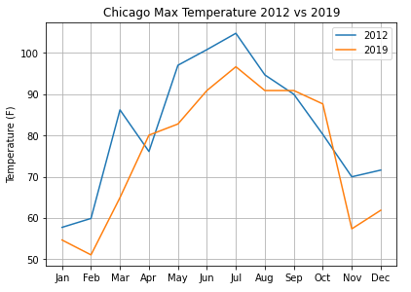
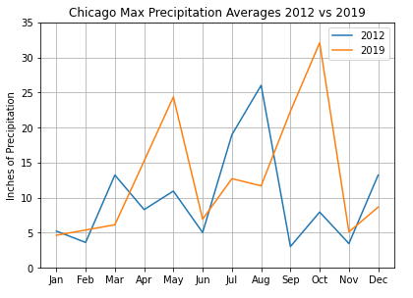
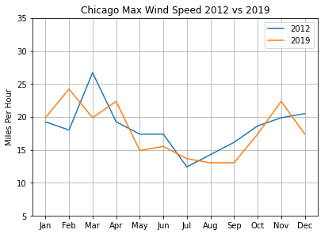
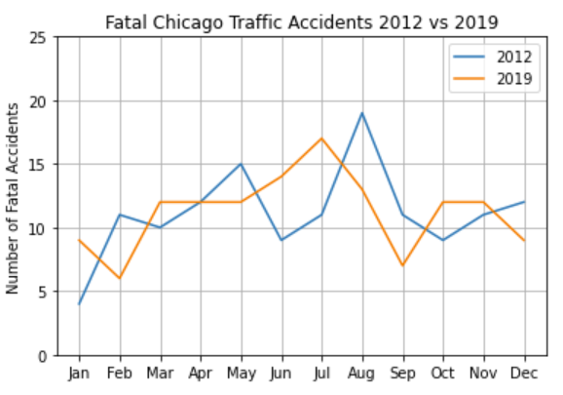
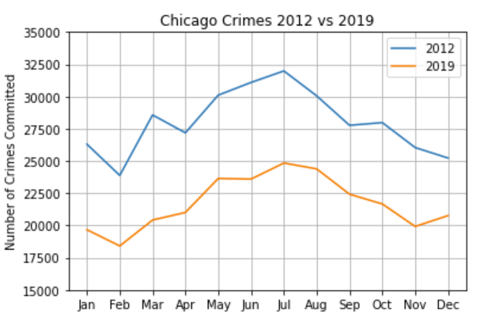
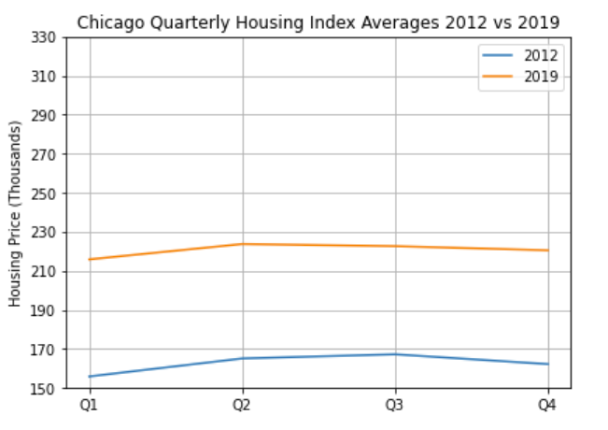
Chicago Summary

Slide 8
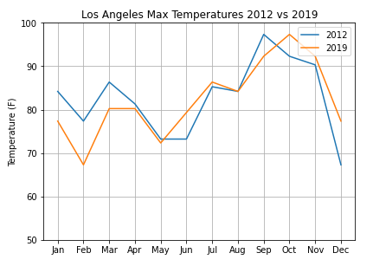
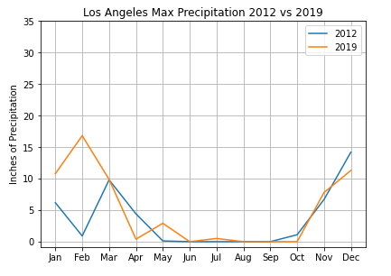
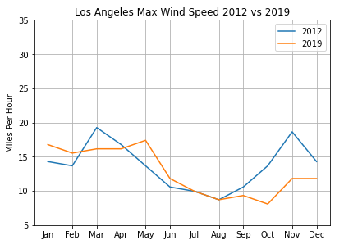
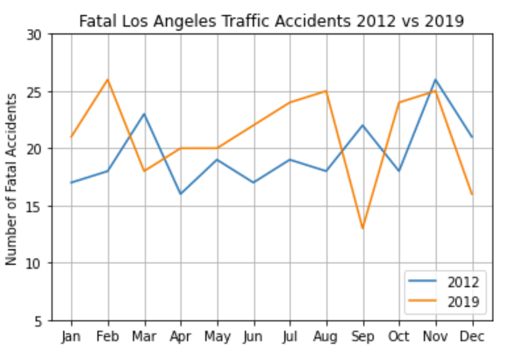
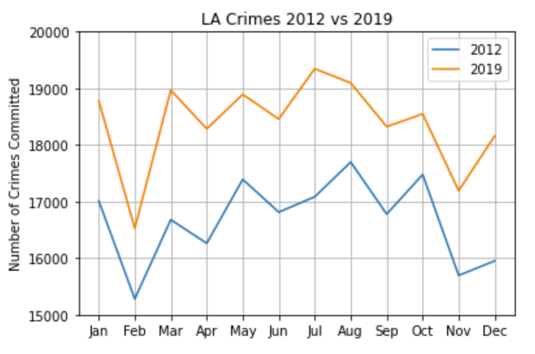
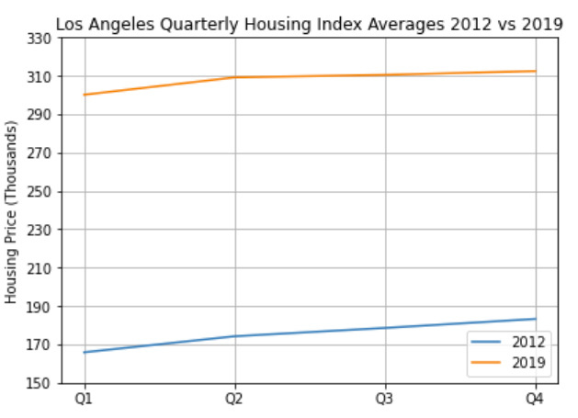
Los Angeles Summary

Slide 9
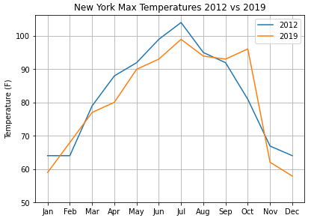
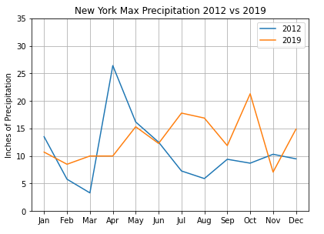
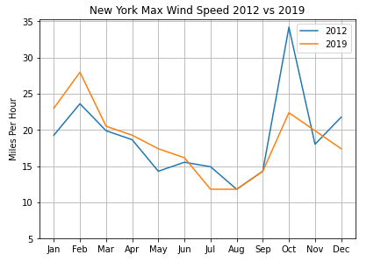
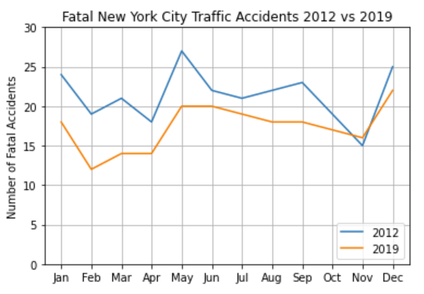
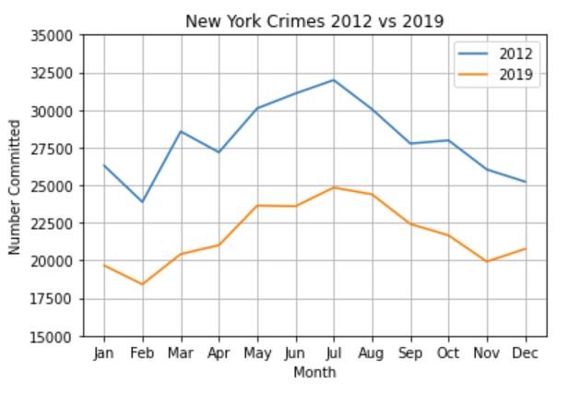
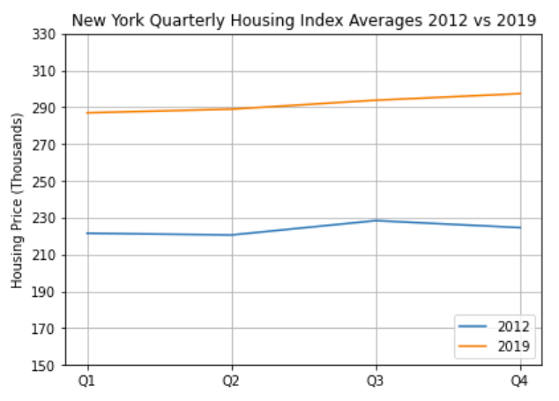
New York Summary

Slide 10
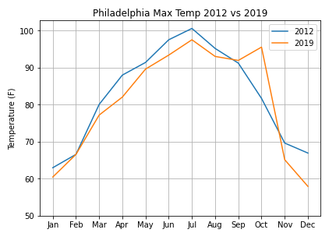
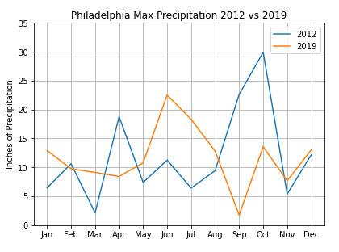
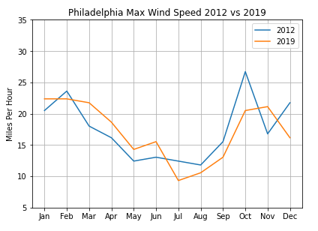
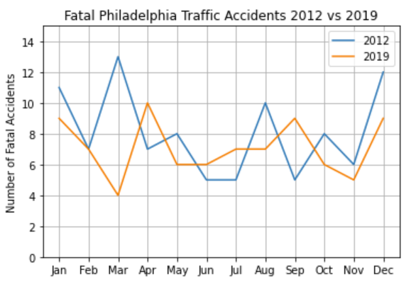
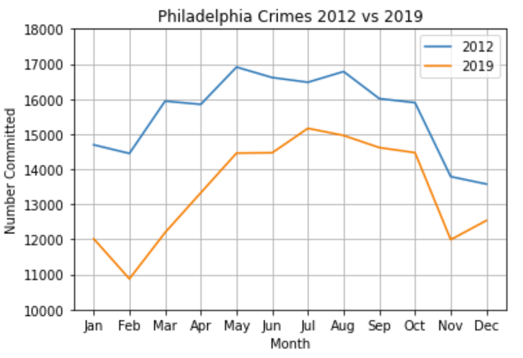
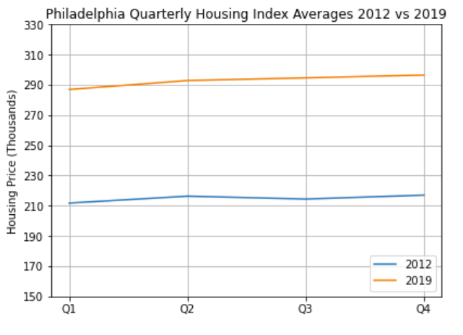
Philadelphia Summary

Slide 11
Conclusion
Is there a correlation between climate change and traffic fatalities?
Chicago:
2012: Low, stronger than 2019.
2019: Low
Los Angeles:
2012: Low, stronger than 2019.
2019: Low
New York:
2012: Yes, stronger than 2019.
2019: Low
Philadelphia:
2012: Low
2019: Low

Slide 12
Conclusion
Is there a correlation between climate change and crime?
Chicago:
2012: Yes
2019: Yes
Los Angeles:
2012: Low
2019: Low
New York:
2012: Yes
2019: Yes
Philadelphia:
2012: Yes
2019: Yes
Is there a correlation between climate change and property prices?
All cities: Inconclusive

Slide 13
Conclusion
Hypothesis: With climate change, we predict that there is a greater strain on quality of life.
Answer: Inconclusive with our limited datasets.

Slide 14


Most Important Conclusion
What we’ve in life, is best enjoyed with people you care about. learned is that big data, like most of the sweetest things

Slide 15
Data Sources
NYC Crime: Need to combine felony, misdemeanor and violation 2000-2020
https://www1.nyc.gov/site/nypd/stats/crime-statistics/historical.page
LA Crime Index 2000-2019:
https://data.lacity.org/Public-Safety/Crime-Data-from-2010-to-2019/63jg-8b9z
Chicago Crime 2000-present: https://data.cityofchicago.org/Public-Safety/Crimes-2001-to-Present/ijzp-q8t2
Philadelphia Crime Rates:
https://www.opendataphilly.org/dataset/crime-incidents
Traffic Fatalities:
https://www.nhtsa.gov/crash-data-systems/fatality-analysis-reporting-system
Property Values:
https://www.fhfa.gov/DataTools/Downloads/Pages/House-Price-Index-Datasets.aspx#mpo
Weather Data:
https://meteostat.net/en

Slide 16

GitHub Repo
https://github.com/c-daily/UPenn_Project1

